Slide 1
Immersive Data Analysis – Project 1
Allende
Sikhote-Alin
Allende
Piancoldoli
Bethlehem
plus over 38,000 more! … in this Data Set!

Slide 2
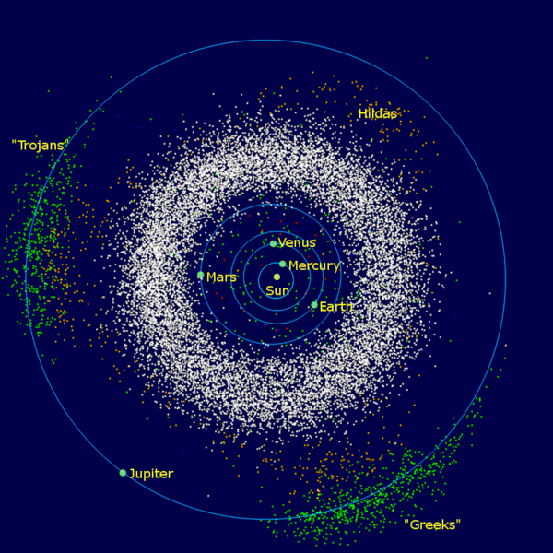
Asteroids?
C-type – Carbonaceous chondrite meteorites.
S-type – Stony meteorites.
M-type – Iron meteorites.
V-type – HED meteorites

Slide 3
Asteroid Trivia
Most expensive asteroid - The Fukang Meteorite - €1.7 million
How many hit earth’s atmosphere – 500 a day, 30 hit the earth per year
Smallest size asteroid to hit earth? Marble
Speed? 25,000 to 168,000 mph
What killed the dinosaurs? 6.8 to 50.3 mile dia - Chicxulub crater, MX
Ceres – ¼ the moon, orbit is around the moon between Mars and Jupiter in a region called the asteroid belt, spherical

Slide 4
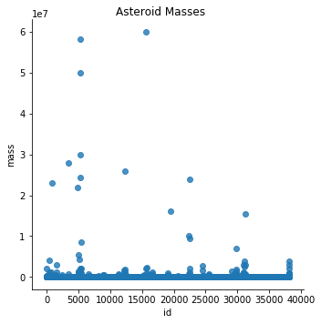
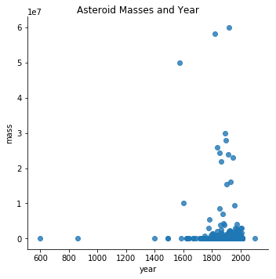
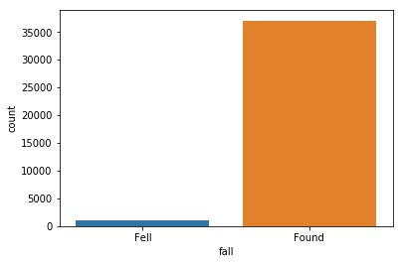
Asteroids - Python

Slide 5
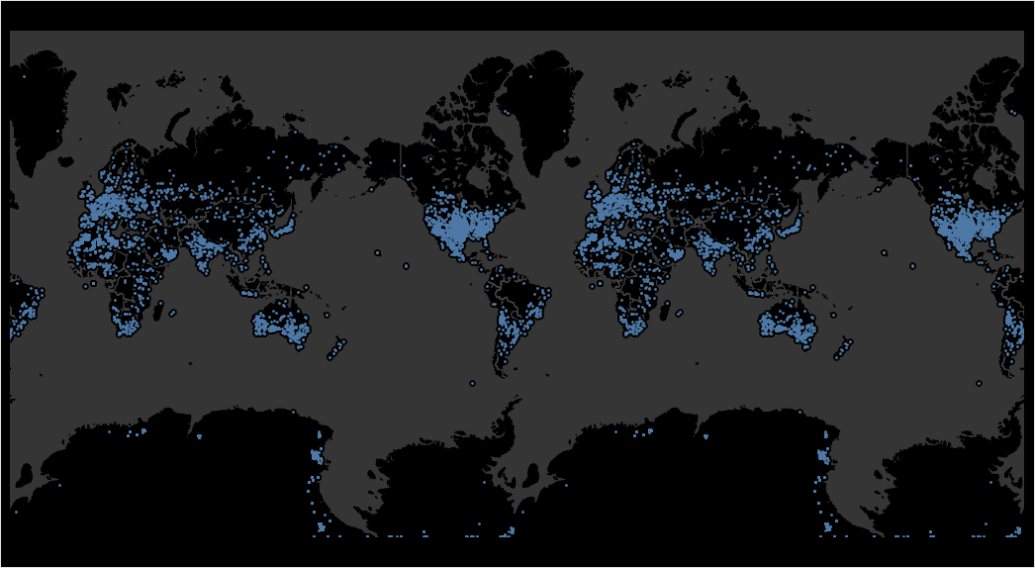
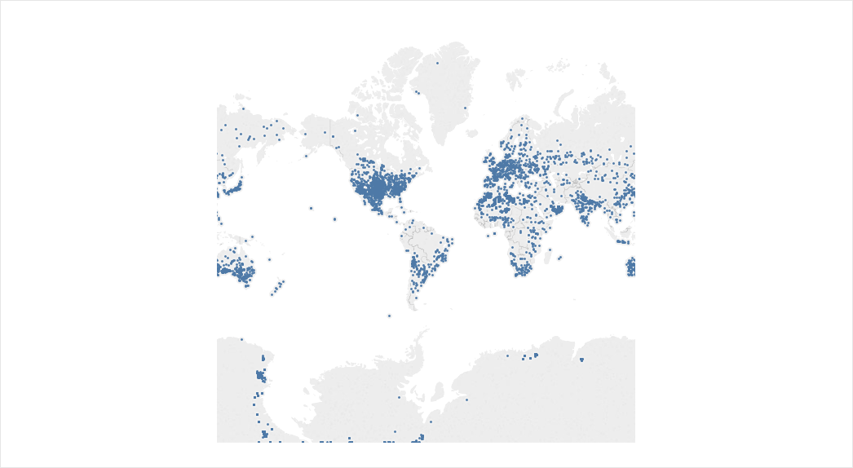
Asteroids - Tableau

Slide 6
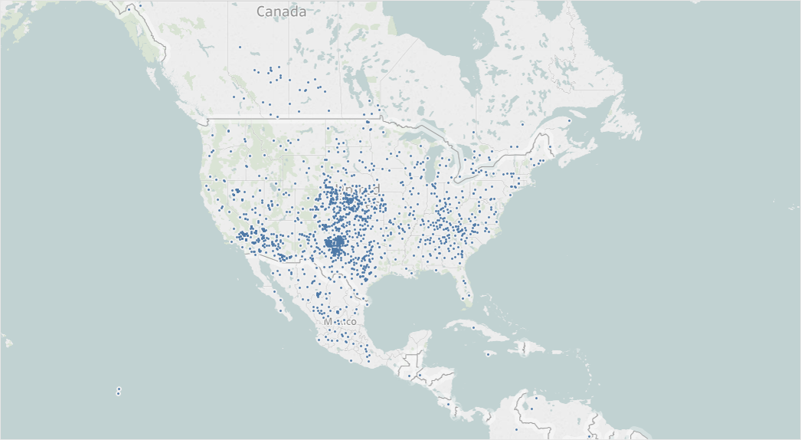
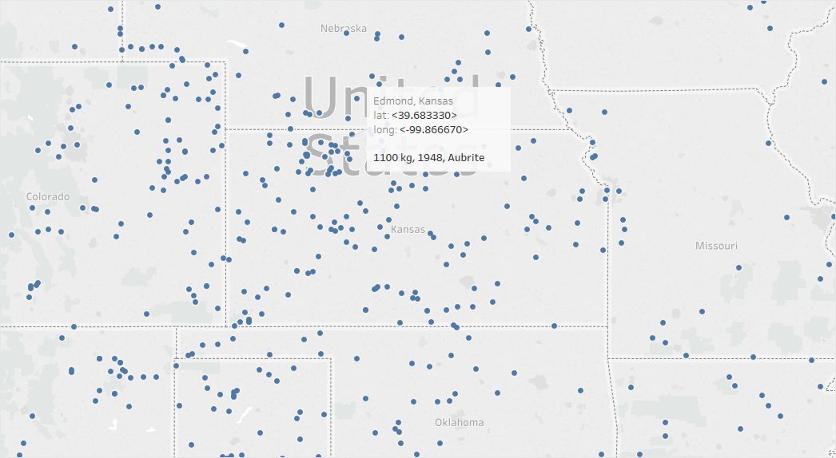

Slide 7
